Slide 1
Dulwich Streetspace Review
Community meeting 19th June
Chair Cllr. Andy Simmons

Slide 2
Welcome
To help the meeting run smoothly, please:
Keep your microphone muted unless invited to speak and do not interrupt other speakers.
Change your on screen name to your first name and your street/business so we can try to hear from a range of participants.
Use the ‘Chat’ function to leave comments – please be polite and considerate to other participants.
Use the ‘raise hand’ function if you wish to ask a question during the Q&A sections of the meeting,
Note that the meeting is not being recorded.
Remember that you can submit comments outside of the meeting, by visiting http://www.southwark.gov.uk/dulwichstreetspacereview or by email to streetspace@southwark.gov.uk

Slide 3
Agenda
Streets for people – Low traffic measures in Southwark
Experimental measures in Dulwich
Monitoring the effects
Consultation and next steps
Breakout session 1: Goals and outcomes
Breakout session 2: Looking forward

Slide 4
Overview
Highway measures were introduced in 2020 under Experimental Traffic Management Orders (ETMOs)
To assist social distancing and encourage active travel by reducing car use, promoting walking and cycling, and improving the on-street experience.
Built upon the work of the Our Healthy Streets – Dulwich project
ETMOs must either be removed or made permanent a maximum of 18 months

Slide 5
Our Aims – Streets for People
Make our roads safer for all residents and visitors.
Make walking and cycling an enjoyable, safe and easy way of getting around,
Clean up our air, reducing pollution and noise levels, and creating a greener and healthier environment for everyone.
Help tackle the climate emergency, reducing the carbon emissions from vehicles in Southwark, as they are one of the biggest contributors to emissions locally.
Reduce the amount of cut-through traffic so all feel safer on local roads, as well as reducing parking pressure for local residents.
Encourage people to shop local, so our local high streets flourish

Slide 6
Actions to date
We have:
Created 39 School Streets to improve road safety outside schools
Opened more cycle routes so residents can cycle safely around our borough
Installed over 70 cycle hangars across Southwark since April 2020, with a further 200 to be installed by March 2022, many of which to be located in the Dulwich area along with cycle stands
‘Greened’ streets so children can play outside
Implemented Experimental Traffic Management Orders in Champion Hill, Dulwich Village and East Dulwich
Made changes with Transport for London to help the flow of traffic on main roads with new light signalling and safer crossings.
Made changes in response to the COVID-19 pandemic. These included making space for social distancing and helping people to walk and cycle more to avoid public transport.

Slide 7
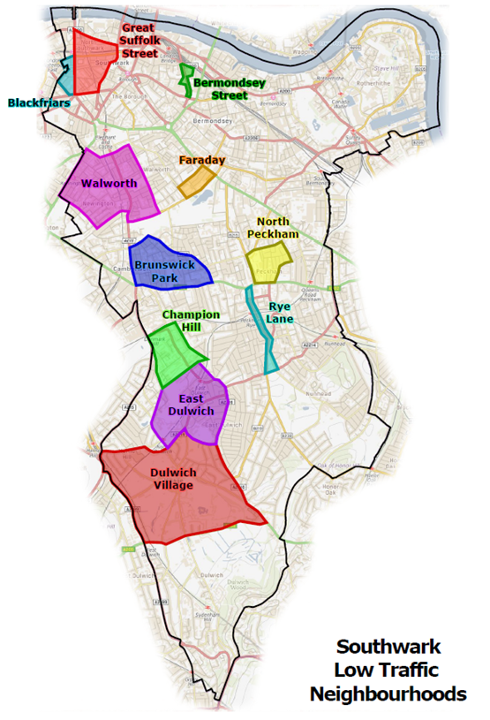
  Low Traffic Interventions in Southwark
  ULEZ
  TfL extending current boundary to south circular in October 2021. Potential to reduce the more polluting vehicles, but won’t necessarily affect vehicle numbers
  Congestion Charge
  Transport for London Funding
  Strategic London Transport Schemes

Slide 8
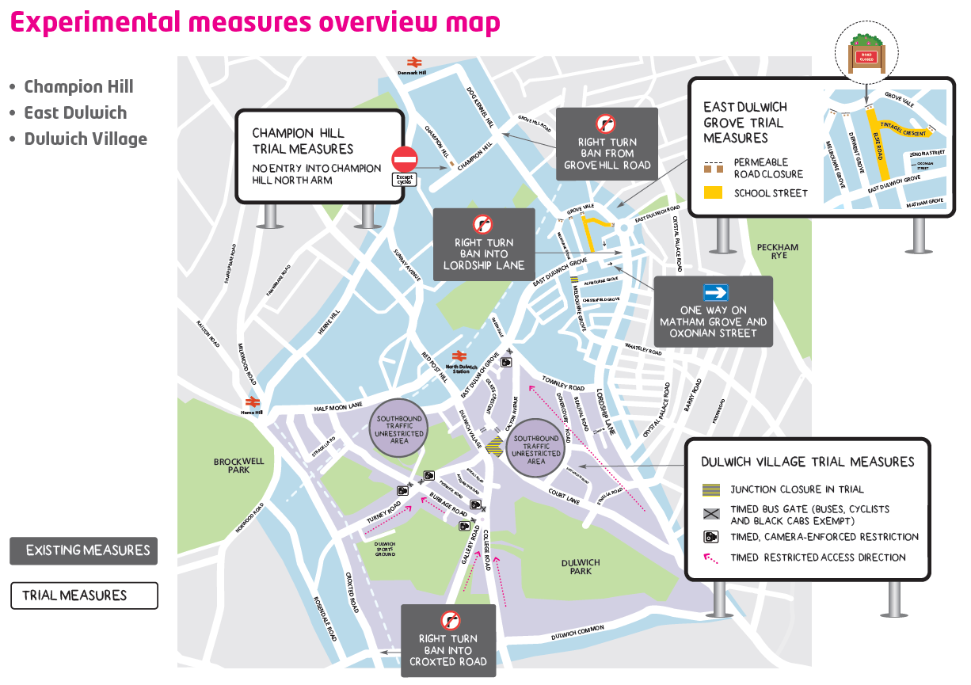

Slide 9
Key changes being considered
The key measures, which we are monitoring and consulting on, include:
A traffic filter at the junction of Dulwich Village with Court Lane and Calton Avenue – preventing access to all motor vehicles
Timed access filters on Dulwich Village, Turney Road, Burbage Road and Townley Road, restricting motor vehicle access (except buses, taxis and local disabled badge holders) between 8-10am and 3-6pm Monday-Friday
Traffic filters on Melbourne Grove , Tintagel Crescent, Elsie Road and Derwent Grove preventing motor vehicle access to Grove Vale
Retaining the northbound traffic filter on Champion Hill

Slide 10
Recent changes
We will be installing a total of 11 pay-by phone parking bays on Melbourne Grove, Derwent Grove, Elsie Road and Grove Vale, providing customers additional parking options.
We will be installing 2 shared-use bays on Derwent Grove to improve parking capacity for residents and shoppers.
We have installed seating and planting on Melbourne Grove and Elsie Road, in addition to increasing the cycle parking provision on Melbourne Grove.
We have installed seating and planting in Dulwich Village to encourage people to spend more time visiting shops and cafes here.
We will be introducing parking restrictions to the echelon/diagonal parking bays in front of the shops in Dulwich Village to make it easier for people visiting the shops. We will also be introducing a disabled bay.

Slide 11
Monitoring Criteria
Reduce traffic, considering principal roads and the inner area together (MC1)
Encourage people to use active travel modes and improve experience for those who already actively travel (MC2)
Encourage walking, cycling and active travel modes for the journey to school and improve experience for those who already actively travel (MC3)
Re-allocate kerbside space to create social spaces and encourage physical activity. (MC4)

Slide 12
How we will monitor the changes
What we will measure | Measurement tool | Comparative data | When we will measure
Vehicle movements on roads within low-traffic neighbourhood | Automatic Traffic Counts Transport for London (TfL) permanent traffic counts | Baseline (pre-Covid) | June 2020, September 2020, March/April 2021, June 2021 September 2021
Vehicle movements on peripheral roads to low-traffic neighbourhood | Automatic Traffic Counts Transport for London (TfL) permanent traffic counts | Baseline (pre-Covid) | June 2020 September 2020 January – December 2021
How roads perform (traffic delays, congestion) | TfL bus performance data (IBus) Impact on waste collection Impact on emergency services Junction counts Air quality data trends Traffic mapping services and telematics | Baseline (pre-Covid) | As available
People cycling | Automatic Traffic Counts Active Travel Monitors | Baseline (pre-Covid) | June 2020 September 2020 January – December 2021
How pupils travel to school | Hands Up Surveys School surveys Young people engagement work | Baseline (pre-Covid) | Spring 2021
Active Travel uptake amongst residents | Consultation | Partial baseline (OHS Dulwich, Census 2011) | Spring 2021
Dwell time in high street areas | Consultation Active Travel Monitors | Baseline (OHS Dulwich Phase 2) | Spring 2021
How people view the scheme | Consultation | Partial baseline | Spring 2021

Slide 13
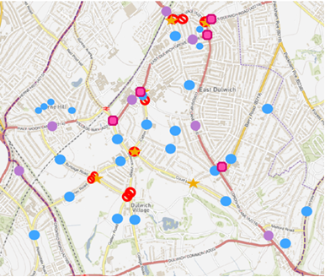
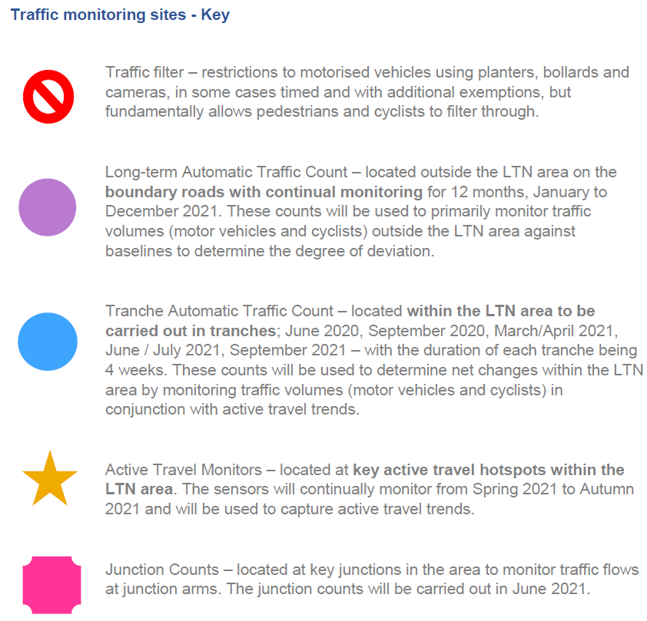
Traffic Monitoring sites – Dulwich

Slide 14
Traffic Monitoring sites – Champion Hill

Slide 15
Air quality monitoring
Map of air quality diffusion tubes

Slide 16
Monitoring Data :
Air quality NO2 monitoring – plus particulate modelling.
SCOOT junction data from TfL to inform of junction saturation at signalised junctions
ibus data to inform of bus journey times particularly highlighting degree of deviation from average journey times
TLRN network analysis at permanent count sites
Emergency response times
TfL permanent count sites in Southwark and neighbouring boroughs (this will be used to show traffic trends as proxy)
Traffic speeds (collected through ATCs)
Cycle / pedestrians count
Working/ sharing data with TfL and Lambeth council
Initial data sets in relation to March/ April are being compiled and will be available to inform the additional community meetings in late June / July and the stakeholder engagement process.

Slide 17
Consultation
Online consultation runs until 11th July, at www.southwark.gov.uk/dulwichstreetspacereview
Community meetings 23rd May, 26th May and 19th June
Dedicated meetings to be arranged with:
  Local resident, amenity and road groups
  Active travel and air quality groups
  Local traders
  School leaders
  Emergency services
  Disability organisations and disabled residents
  Black, Asian and Minority Ethnic communities
Written comments invited from all Residents’ Associations and all other community organisations

Slide 18
What happens after consultation
We will review the information gathered and decide whether to:
Make all or part of the scheme permanent
If the data and consultation feedback indicates that the trials are meeting our objectives, we will recommend making the current experimental traffic management orders permanent.
Make amendments to the experimental scheme
If the data, consultation feedback and safety considerations indicate that changes can be made to improve a scheme then we will recommend making amendments.
Remove all or part of the scheme
If the scheme is not achieving the benefits expected, we can remove all or part of the scheme (subject to safety considerations).

Slide 19
Overall timeline
The public consultation stage runs between mid-May and early July.
Conversations and meetings with stakeholder groups continuing until the end of autumn
There will be further community meetings to discuss the monitoring data
Consultation responses and data gathered will be analysed between mid-July and mid-August 2021
Recommendations on the way forward will be considered by the Council in the autumn.
If changes are approved, statutory consultation will take place on a Traffic Management Order prior to a final decision to implement any permanent changes.

Slide 20
Breakout Session 1: Goals and Outcomes
Do we accept the goals of the streetspace measures?
If not, what might we change?
Have the measures achieved the goals set?
What are some of the consequences or issues?

Slide 21
Breakout Session 2: Looking forward
What do we do with the Streetspace measures – keep, cancel, amend?
What are the future steps to achieve our goals and help create a healthier future for the Dulwich area?

Slide 22
Feedback
Top 2 comments on the current Streetspace measures
Top 2 ideas about what to do going forward to achieve a healthier future for the Dulwich area

Slide 23
How can I express my views?
Further community meetings coming soon. Register to attend at https://dulwichreview.eventbrite.co.uk
Background information and the consultation itself at www.southwark.gov.uk/dulwichstreetspacereview
Request a hard copy of the survey by email or by writing to:
Highways – Dulwich Review,
3rd Floor, Hub 2,
160 Tooley Street,
London, SE1 2QH
Email to streetspace@southwark.gov.uk

