Slide 1
  Workforce report playback session

Slide 2
Agenda
Welcome and introductions
Overview of the Annual Workforce Report
Highlights of the key information from the Annual Workforce Report
An update on work undertaken last year to address inequalities and an overview of work going on this year
Summary and next steps for 2021 and beyond

Slide 3
Overview of the workforce report
The annual workforce report has been conducted annually by Southwark Council for more than 10 years
The workforce report covers key information from across the workforce. A statutory obligation to publish this information under the Public Sector Equality Duty (Equality Act, 2010).
The report is an appendix to the Cabinet report which explains key projects, initiatives and activities that have been implemented from the Councils Workforce Equalities Plan during 2019-20 .
The current workforce report covers 1st April 2019 to 31st March 2020. This is presented to Cabinet in December.
The purpose of this playback session is to highlight key data and information from the workforce report and how this has been addresses in the Councils Workforce Equalities plan in relation to:-
          Ethnic origin
          Disability
          Sickness absence
          Age
          Apprenticeship
          Sex
          Maternity/paternity/adoption leave
          Sexual orientation
          Recruitment
          Training
Notes:
Appendix one of the workforce report covers
• Workforce Numbers & Employee Profiles
• Changes in the Workforce
• Performance Management and Increments
• Sickness
• Learning & Development
• Disciplinary Investigations & Outcomes
• Capability Action & Outcomes
• Staff Complaints
• Respect at Work
• Recruitment
• Agency Workers
• Pregnancy & Maternity

Slide 4
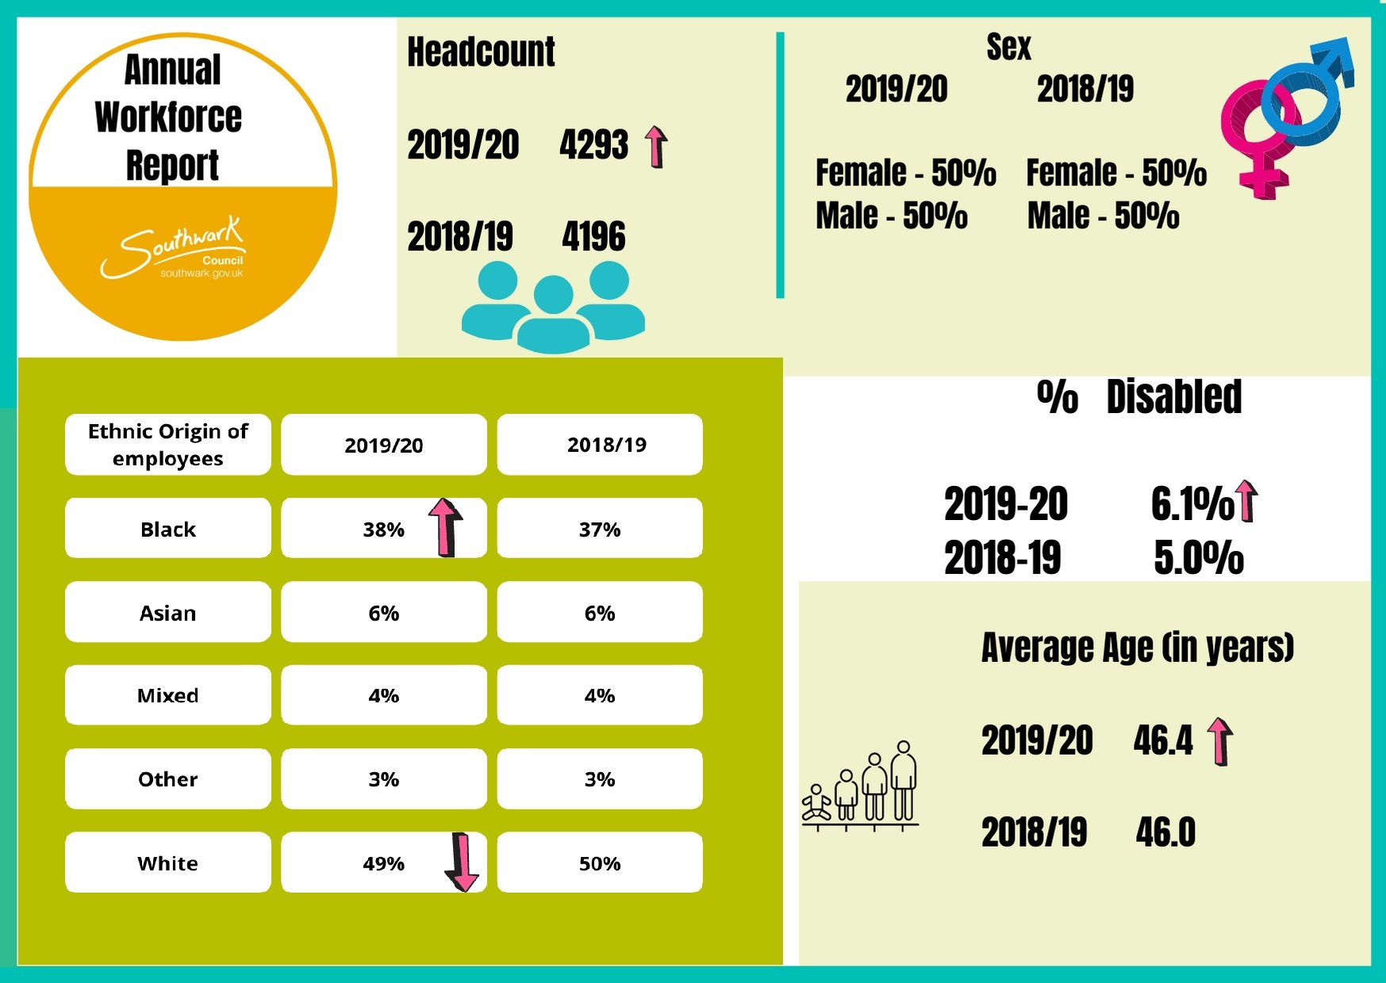
Workforce overview
Notes:
Headcount
A workforce population of 4,293 is an increase of 2.3% of employee numbers from 2018-19.
Sex
The percentages of female and male employees are equal; 50% of employees are female; 50% are male. (Reference data 3). The sex split shows no change from last year
Disability
The percentage of people formally sharing a disability, 6.1% (260 individuals) has increased by 1.1% compared to the previous year
Ethnic origin of employees
There is minimal change in the percentage of employees who classify themselves as white (49%) with a slight increase of staff who classify themselves as black from 37% to 38%. However, the percentage of staff who identify as Mixed, Other or Asian has not changed since last year.
Age
The average age of employees is marginally the same at 46.4 years

Slide 5
Broad ethnic profile

Slide 6
Ethnicity by department
Broad ethnic origin of employees as percentage of departmental headcount
% | Asian | Black
Chief Executive's Department | 10% | 8%
Children's & Adults Services | 6% | 42%
Environment & Leisure | 4% | 34%
Finance & Governance | 8% | 33%
Housing & Modernisation | 7% | 47%
Place & Wellbeing | 9% | 16%
Total across the council | 6% | 38%
Mixed | Other | White
0% | 0% | 82%
4% | 3% | 45%
3% | 3% | 56%
4% | 3% | 52%
5% | 3% | 38%
3% | 5% | 67%
4% | 3% | 49%
Notes:
Largest percentage of Asian staff are located in CE Department
Largest percentage of Black and mixed staff are based in Housing and Modernisation
Largest percentage of staff who identify their ethnic origin as other are based in Place and Wellbeing
Largest percentage of white staff are based in CE department

Slide 7
Ethnicity
Grade distribution by broad ethnic origin
.
*
Notes:
The percentages of Black, Asian and Minority Ethnic employees are lower in grades 14 and above.
22% of senior council officers at Grade 14 (Head of Service or equivalent) and above are black, Asian or from minority ethnic groups, this has increased by 4% from the previous year
Other grade bands* - mainly consists of employees on various TUPE conditions

Slide 8
Southwark Borough Plan Workforce Commitment, Measures and Milestones

Slide 9
What we have done in to 2019/20
Actions for 2020/21
We have increased representation of employees with a Black, Asian and Minority Ethnic background in grades 14+ by 4% in the last year to 22%.
A leadership network event titled ‘Diverse Voices’ took place in Autumn 2019
Targeted recruitment via the local community which led to 88% of internship applicants from a Black, Asian and Minority Ethnic background.
  Raising awareness through anti-racist events such as Show Racism the Red Card.
  EMPower is the staff network group for Black, Asian and Minority Ethnic employees, they have facilitated a range of targeted events
  The Council is now committed to ensuring the top of the council’s workforce grade 14+ is representative of the ethnic diversity of the local working age population by 2030, currently this is 38% of our community.
  Promoting role models through career development stories
  Members will be monitoring our progress on a quarterly basis through reviewing the annual workforce equalities plan and key metrics
  Progressing work on the Southwark Stands together workforce workstream in conjunction with a specialist EDI consultant

Slide 10
Disability profile of the workforce

Slide 11
Disability Profile of the workforce
Notes:
The definition of disabled under the Equality Act 2010 applies if you have a physical or mental impairment that has a 'substantial' and 'long-term' negative effect on your ability to do normal daily activities
The locally economic disabled workforce stands at 6.2, Southwark has 6.1 % representation so is broadly reflective of our community.
Promoting share not declare and #IamConfident
Continued commitment to the government scheme for Disability Confident
The Council is a member of the Business Disability Forum
Ncompass, the Council’s all-inclusive disability staff network was launched in December 2019.

Slide 12
Sickness Absence
Recorded reasons for sickness absence
Reason | 2019/2020 | 2018/2019
Minor conditions | 30% | 45.4%
Muscular skeletal | 20% | 24.8%
Medical conditions | 22% | 19.3%
Stress/ depression/ anxiety/ mental health | 26% | 9.2%
Back problems | 2% | 1.2%
Notes:
Average sickness per person was 7.4 days, shows a slight increase of 0.3 days per person from last year
Staff who had no sickness absence during the year (51%).
Top 5 reasons for sickness absence has seen a change in the figures since last year.
An increase in reporting of ‘stress/ depression/ anxiety/ mental health’, 9.2% in 2018-19 to 26% in 2019 -20
However, there has been a decrease in staff reporting minor conditions and muscular skeletal conditions.
An increase in occupational health referrals related to mental health conditions. 22% in 2018-19 to 31% in 2019 -20

Slide 13
What we have done in 2019/20
Actions for 2020/21
As part of the pre-procurement of our Occupational Health Service contract, key consideration was given to the support that the service can provide to support staff with mental health issues in the workplace
Development of the well being microsite, so staff can access key information directly from their mobile or personal laptop
A continued commitment to the Time to Change pledge which places a particular focus on reducing the stigma associated with mental ill-health
Mental health programmes, initiatives and awareness campaigns were held during the year to help tackle the stigma of mental health
Engage with NCompass, the disability staff network on a range of initiatives, such as, providing feedback to the Smart Working programme and providing advice and guidance to the Cycle to Work re-procurement process
Wellbeing webinars for staff on a range of topics to support positive mental wellbeing
Develop and circulate winter wellbeing plans
Refresh disability guidance, especially around mental health
Wellbeing strategy inc. work towards excellence with the healthy workplace charter
Progress from a Disability Confident Employer to become a Disability Confident Leader

Slide 14
Age profile of the workforce

Slide 15
Age of the workforce
Notes:
The average age of employees is 46 years.
The largest staff group is in the 40-54 years banding (39%)
The Council aims by 2022 to make sure 100 young people from low income backgrounds obtain paid internships within the organisation

Slide 16
What we have done in 2019/20
Actions for 2020/21
Bespoke initiatives that are being offered to support our ageing workforce of different ages:
  Recognition of their long public service with the Annual Long Service Awards
  Annual Apprenticeship awards
  Regular publication of a youth opportunities bulletin promoting youth opportunities within the council and the wider Southwark community
  Planning for your retirement courses
  Pensions planning events
  Financial planning support through the employee assistance programme
  The introduction of the Lead trade and craft operative role, creating posts for experienced staff who can train, coach and mentor newly qualified trades people
Develop options for a ‘good retirement’ in partnership with Centre for Policy on Ageing including pensions guidance refresh with actuaries
Continue focus on apprenticeships and attraction of younger workers
Reintroduce literacy & numeracy NVQs

Slide 17
Apprenticeships
Notes:
- council plan target to have 3% workforce who are apprentices or first entry trainees – currently at 4.1% and make up 29% of new joiners for the year (up 8% from the year before)

Slide 18
Apprenticeships
Notes:
The Council had 151 apprentices in 2019-20. This equates to 4.1% of our workforce
29% of our total new joiners for the year were apprentices. An increase of 8% from 2018/19

Slide 19
Apprenticeships
Notes:
109 apprentices secured a promotion or employee grade increase on completion
49% of our Black, Asian and Minority Ethnic apprentices/trainees have changed grade (increasing their salary) and gained a promotion since completing their apprenticeship or training programme
The Council retained and recruited into permanent or fixed term contract positions 49% of apprentices.
We also have our internship programme and we hope to start providing more data on that – we are committted to make sure 100 young people from low income backgrounds get paid internships at the London Living Wage – this was launched in Autumn 2019 and was slightly derailed by the pandemic but despite that we are on track with over 20 interns to date

Slide 20
Sex profile of the workforce

Slide 21
Sex of the workforce by department
Notes:
Southwark has a split of 50% women and 50% men in the workplace
The largest number of male staff are based in Environment and Leisure
The largest number of female staff are based in Children’s and Adults services

Slide 22
Maternity/paternity/adoption leave
Notes:
This is the first year we are reporting on this data
Of the women who took Maternity or Adoption leave during 2019/20, 73% returned to work.
Shared Parental Leave (SPL) is offered by the council. However, no staff or their partners used SPL in this reporting year.

Slide 23
What we have done in 2019/20
Actions for 2020/21
The Council continues to support key initiatives and challenge stereotypes to maintain a good balance between our male and female workforce. Some of the bespoke initiatives achieved including:-
Development of the Menopause and Domestic Abuse policies
Acknowledging and Marking the United Nation’s International Day for the Elimination of Violence against Women and Girls and our support for the 16 days of activism.
The Council’s staff group, the Women’s network have delivered events and incentives that have raised awareness on issues and interests related to women. As well as facilitating a range of events on topics, such as, childcare, dementia and breast health awareness
Addressing the gender pay gap issue created by the payment of the bonus scheme, under Trade and craft Operative Terms and Conditions of service
Review flexible working practices to ensure working parents are supported on return from maternity or paternity leave
Review facilities and practices in more male dominated teams to ensure women are welcomed
Analysis of gender pay amongst third party contracts
Revising the policy on premature births
Explore leadership and mentoring programmes for women and Black, Asian and Minority Ethnic staff

Slide 24
Sexual orientation of the workforce

Slide 25
Sexual orientation of the workforce
Notes:
The Council does not hold enough data on gender reassignment or sexual orientation, for it to be statistically significant.
Southwark as a borough, has the second highest gay or bisexual population in London with 5.8% of the population and our workforce is broadly reflective of this figure.
The Council’s LGBTQ+ staff Network has been a positive initiative for the engagement of staff from the LGBTQ+ community. Key events have been run by the network to raise awareness and inclusiveness within Southwark workforce
Development of a new Transgender and gender identity guidance

Slide 26
What we have done in 2019/20
Actions for 2020/21
  Bespoke initiatives focusing on sexual orientation have included public and internal promotion of events to support LGBTQ+ staff and raise awareness
  Development of the Transgender and Gender Identity Guidance which has been consulted and approved by our Corporate Trade Unions
  The LGBTQ+ staff network held a number of events:
  Celebrating LGBT History Month collaborating with local book sellers, artists and historians
  Celebrating Pride Month with film screenings, events in the Tooley Street Atrium and talks
  Celebrating Transgender Awareness Week - Film screening
  Holding an intersectionality event “3 women, 3 stories”, highlighting the lived experiences of queer women
Embedding the transgender guidance and training managers and staff
Supporting the LGBTQ+ network and working together to celebrate key awareness days whilst promoting inclusivity and equality including:-
LGBT+ History Month
Trans visibility week and international transgender visibility day International Day Against Homophobia, Transphobia and Biphobia
Stonewall riots anniversary
LGBTQ+ staff network working with the other staff networks on initiatives relating to intersectionality

Slide 27
Recruitment and ethnicity

Slide 28
Recruitment + Ethnicity
(Annual Workforce report)

Slide 29
Recruitment + Ethnicity
(Annual Workforce report)

Slide 30
Recruitment + Ethnicity
(Annual Workforce report)

Slide 31
What we have done in 2019/20
Actions for 2020/21
  Developed guidance and designed the recruitment to launch a pilot of the internship programme
  Successful promotion led to 88% of internship applicants coming from a Black, Asian and Minority Ethnic background
  Refreshed Children Social Care microsite – attraction strategy and employer endorsement with good OFSTED feedback
  Launched Recruitment and Retention welcome payment benefit, in Children Social Care SFS and AI for Social Workers and Team Managers
  Refreshed The source – Step by step guidance for hiring managers with videos
  Launched online recruitment and selection course - an overview of the recruitment, selection and resourcing process, including preparation for, and practical experience of, conducting interviews.
  Rolled out Hiring Managers recruitment drop in sessions via MLS
  Designed Yammer Group communication blog – shared experience and feedback platform
  Refreshed candidates application experience - reduce barriers when applying for jobs
  Delivered Social Value project – Interview technique skills and CV writing with Southwark Works
  Increased our following on Social Media to be a employer of choice – LinkedIn, Glassdoor and Indeed - employer branding
  Used inclusive Job Boards for wider audience breaking down barriers that individuals may face when applying for jobs
  Partnership working with South Bank Unii – Job Fair Event for Engineering, Surveyor & Fire Safety
  Review the recruitment and selection process
  Stepping up to become a Disability Confident Leader
  Roll out anonymised application hire
  Re-procure an Application Tracking System technology - a software solution to manage all recruitment needs that serves as a data bank for all hiring processes
  Strategic approach to recruitment - data-based means improve our resourcing decisions with good-quality data to forecast hiring demands
  Diversity strategy - variation in efforts to attract diverse candidates to senior level
  Developing more talent in-house, including to fill hard-to-recruit-for positions and sponsoring relevant professional qualifications
  Graduate training programme with linked career pathway – inc. Apprenticeship and Internship
  Refresh our offering for Occupational Assessment - conducting tests/assessments online.

Slide 32
Learning and Development

Slide 33
Equalities monitoring of training courses
.
Notes:
46.4% of our staff from a White background (representing 23.2% of the total workforce) undertook training either classroom-based or e-learning compared to 50.3% of our Black, Asian and Minority Ethnic staff (representing 24.7% of the total workforce)

Slide 34
Equalities monitoring of training courses
Notes:
Managers are encouraged to apply for sponsorship to attend one of the Council’s ILM accredited leadership and management qualifications which are offered at levels 2, 3, and 5

Slide 35
What we have done in 2019/20
Actions for 2020/21
A number of universal learning and development initiatives were launched in 2019-20 and communicated widely to ensure that our Black, Asian and Minority Ethnic staff had access to training opportunities:
Increased emphasis on the importance of the career development conversation at mid-year reviews
The launch of the coaching and mentoring programme
Embedding of the career development portal
Continued provision for the Professional Qualification Scheme
Continued provision of the equalities training for council staff and managers with the introduction of unconscious bias training
The digital skills portal was developed and launches as a central hub with key information, guidance and tools to support our staff
Staff without access to The Source are made aware of opportunities for personal development within the PQS programme.
Continue universal learning and development initiatives (as stated to the left)
As part of the Southwark Stands Together workforce workstream, working groups will focus on reviewing the corporate training and development for staff and another working group will look specifically at leadership and management. This will ensure our training and development is fit for purpose
Launch a pilot and roll out wider the reverse mentoring programme
Continue out reporting to management on the completion rate of mandatory training

Slide 36
Summary
Key information about our workforce has been covered in relation to our equalities data and specific protected characteristics
We have outlined the work that has taken place in 2019/20
Positive results have been achieved in some areas
Access to the full workforce statistics report and the Cabinet paper are available via the Source and externally on the Southwark Stands Together - Workforce Workstream microsite–
Internal link
  http://thesource/human-resources/our-workforce/workforce-report/
External link to the SST microsite
  http://moderngov.southwark.gov.uk/documents/s86136/Appendix%201%20Annual%20Workforce%20Report.pdf

Slide 37
Workforce overview
Notes:
To summarise the key data for the workforce based on the last report was:-
Headcount
A workforce population of 4,293 is an increase of 2.3% of employee numbers from 2018-19.
Sex
The percentages of female and male employees are equal; 50% of employees are female; 50% are male. (Reference data 3). The sex split shows no change from last year
Disability
The percentage of people formally sharing a disability, 6.1% (260 individuals) has increased by 1.1% compared to the previous year
Ethnic origin of employees
There is minimal change in the percentage of employees who classify themselves as white (49%) with a slight increase of staff who classify themselves as black from 37% to 38%. However, the percentage of staff who identify as Mixed, Other or Asian has not changed since last year.
Age
The average age of employees is marginally the same at 46.4 years

Slide 38
Next steps
Progress has been made in some areas through targeted initiatives but we recognise that more work needs to be done by:-
  Implementation of the Workforce Equalities plan
  Increasing employee voice and engagement
  Continue with the culture change journey
  Embedding our two new values
  Policies and procedures review
  Measuring improvements against feedback from stakeholders

Slide 39

Open floor for questions

