Slide 1
Southwark Council Safety Valve Proposal
21 September 2022

Slide 2
Southwark Journey
2017-18 Overspend escalating
2018 - 2020 BRB1 – success – reduction in spend £6m and almost balanced in year (RSM) until covid (service and finance)
2022 BRB2 not able to repeat actions of BRB 1 so new approach built on proven track record
Safety Valve - Credible plan but not without risk

Slide 3
Southwark Context
3 world class hospitals: Guy’s, St Thomas’, Evelina Children’s Hospital, Bethlem and Maudsley -Increase in EHC Plans
Very positive SEND Area Review (2018) highlighting practice
Feature in Dfe best practice guidance for governance
Southwark SEND Strategy

Slide 4
Table 1 - High Needs Block position

Slide 5
Programme for Change
Southwark SEND strategy drives the DSG Management Plan, prioritising how we manage demand, need and duties to our SEND CYP within the annual allocated budget.
The plan is focussed on:
Reducing demand for EHCPs into and across the system through a strengthened universal offer and early intervention,
Accelerating movement out of the SEND system through more robust annual review process, working with partners to develop alternative offers, a wholesale review of legislative requirements and practice, promoting independence
Reduce unit costs within the SEND system through benchmarking top ups and commissioning
Provide a cross-agency effective service for children and young people in the system through clear lines of governance and accountability

Slide 6
How we make the difference: SEND Strategy Priority 1
Improving provision for complex/multiple needs, including Autistic Spectrum Disorder (ASD)
Supporting mainstream schools to better meet the needs of children with ASD by using specific ASD focused whole school training and support packages and by relooking at use of local resource bases.
An education capital and sufficiency strategy (including the use of SEND Capital fund) that enables the LA to fulfil its aspiration to develop in borough provision to meet need without an oversupply of specialist places. Development of provision to support mainstream inclusion is key.

Slide 7
How we make the difference: SEND Strategy Priority 2
Provision of more timely, high-quality identification and provision
Early Intervention across 0-25 through development of family hubs
Develop a multi-agency ‘offer’ for families of young children with SEND where the need for an EHCP is reduced.
Map and review services available for Children and Young people moving into borough with high level needs.

Slide 8
How we make the difference: SEN Strategy Priority 3
Development of greater confidence skills and competencies in all settings
Inclusion in mainstream schools- Reduce demand for EHCPs through a strengthened universal offer
Supported by LA advice and consultancy services, outreach services, the SEND school hub, sharing best practice and training.
To be supported by clear documentation, process and training plan.

Slide 9
How we make the difference: SEND Strategy Priority 4
Development of pathways into adulthood for young people with SEND
Development of user lead organisation - 16-25 local day centre
Review of all cases currently supported by an EHCP post 19 -how and where needs can be met locally/more cost effectively with our All Age Disability Service.
Further use and development of personal budgets and provision for young adults
Review of mainstream college post 16 costs and provision to enhance value for money and equity across funding
Accelerate movement out of the SEND system through more robust annual review process, working with partners to develop alternative offers.

Slide 10
Resource allocation reviews and enablers: Priority 5
A wholesale review of legislative requirements and practice, promoting independence
Cultural shift – providers, service users, schools and health
Reduce unit costs within the SEND system through benchmarking top ups and commissioning
A review and subsequent reconfiguration where necessary, of the funding system for all in borough SEND provision

Slide 11
Financial Investment
To meet the priorities of the Southwark SEND strategy and key actions and deliverables, we will invest:
DSG High Needs Block for additional capacity to establish clear guidance on ordinarily available provision, create outreach programmes, expand the inclusion hub into a centre of excellence, and incentivise innovative solutions to support pathway to SEND universal provision
SEND Capital Grant to create additional physical capacity
Council contribution to support the significant change to our services, strengthen our joint commissioning arrangements and ensure our current staffing levels and structures are sufficient to support SEND casework
Notes:
The SEND area review recognised our strong partnerships with health colleagues for SEN children and young people.
Health funding is provided in a number of areas such as 1:1 nursing or health care assistant input for acute health needs during the day in school
therapies input is provided to our special schools for children with dysphasia or other clinical needs.
However we need to ensure that health input is sufficiently impacting on those with EHCPs. This will be pursued through the SEND governance board and our health partners reporting to the Partnership Southwark (ICS).
The overall programme of work requires a project manager. This is a high level role to coordinate all the actions, hold leads to account, collate data monthly, write monitoring reports and keep the project on track.
Capacity building focussing on targeted Annual Reviews. Team of four teachers over four years to review preschool to school, primary to secondary, secondary to FE and FE to post 19 plans. (EDU15)
Commissioning officers to enable the work with colleges and the User Led Organisation (ULO). (EDU17)
A systems programme manager is required to oversee the installation of the data management system, ensure data quality and SEND processes are automated and run smoothly. Whilst data is held in manual systems, a data analyst will also be required to assist.

Slide 12
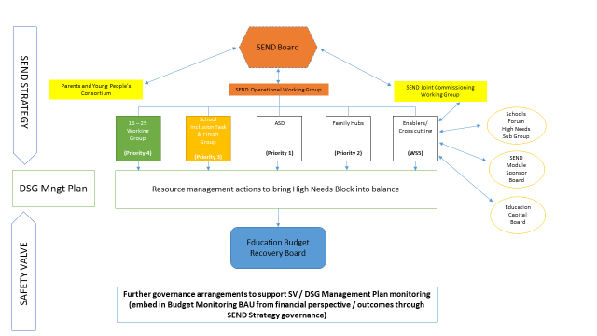
Governance
Notes:
Southwark’s approach to governance features in DfE best practice
Proven track record of budget recovery through Budget Recovery Board process. (see next slide)
Chaired by section 151 officer and strategic Director Children and Adults.
Oversight by Chief Executive
Reporting to Cabinet
Independent auditing and assurance by RSM

Slide 13
Capital investment
Programme of increasing quality and capacity already underway
£9 million of DfE capital already committed
Seeking further £3.5m which council will match fund

Slide 14
Risks

Slide 15
Additional slides

Slide 16
Southwark context 94,000 CYP under 25 years old 9th highest LA population density in England and Wales. 40th most deprived English LA, 40% pupil premium eligibility (Nat Ave 25%) 3rd highest prevalence of SEN in London (increased from 5th in 2017) 9,422 CYP identified as having SEN (SEN support & EHCP) 2,900 (approx.) CYP have an EHC Plan Significant proportion of our LAC have an identified SEN Most persistent need is ASD, accounting for 50% EHC Plans Surplus capacity (pressure on budgets)

